Slide 1

Nandha gopal M project
Namma kadai

Slide 2
First need to create a user
Then You Login your Account and Enter to the Shop
In Firstpage Select the Action Whatever You need

Slide 3
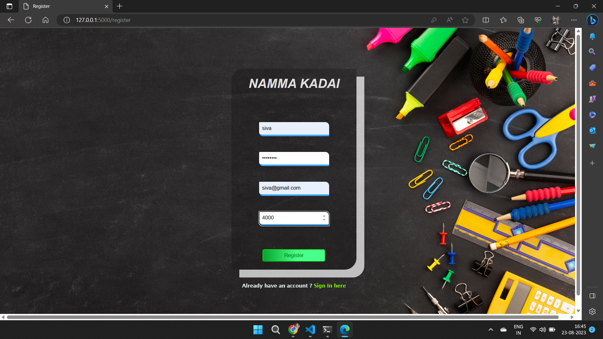
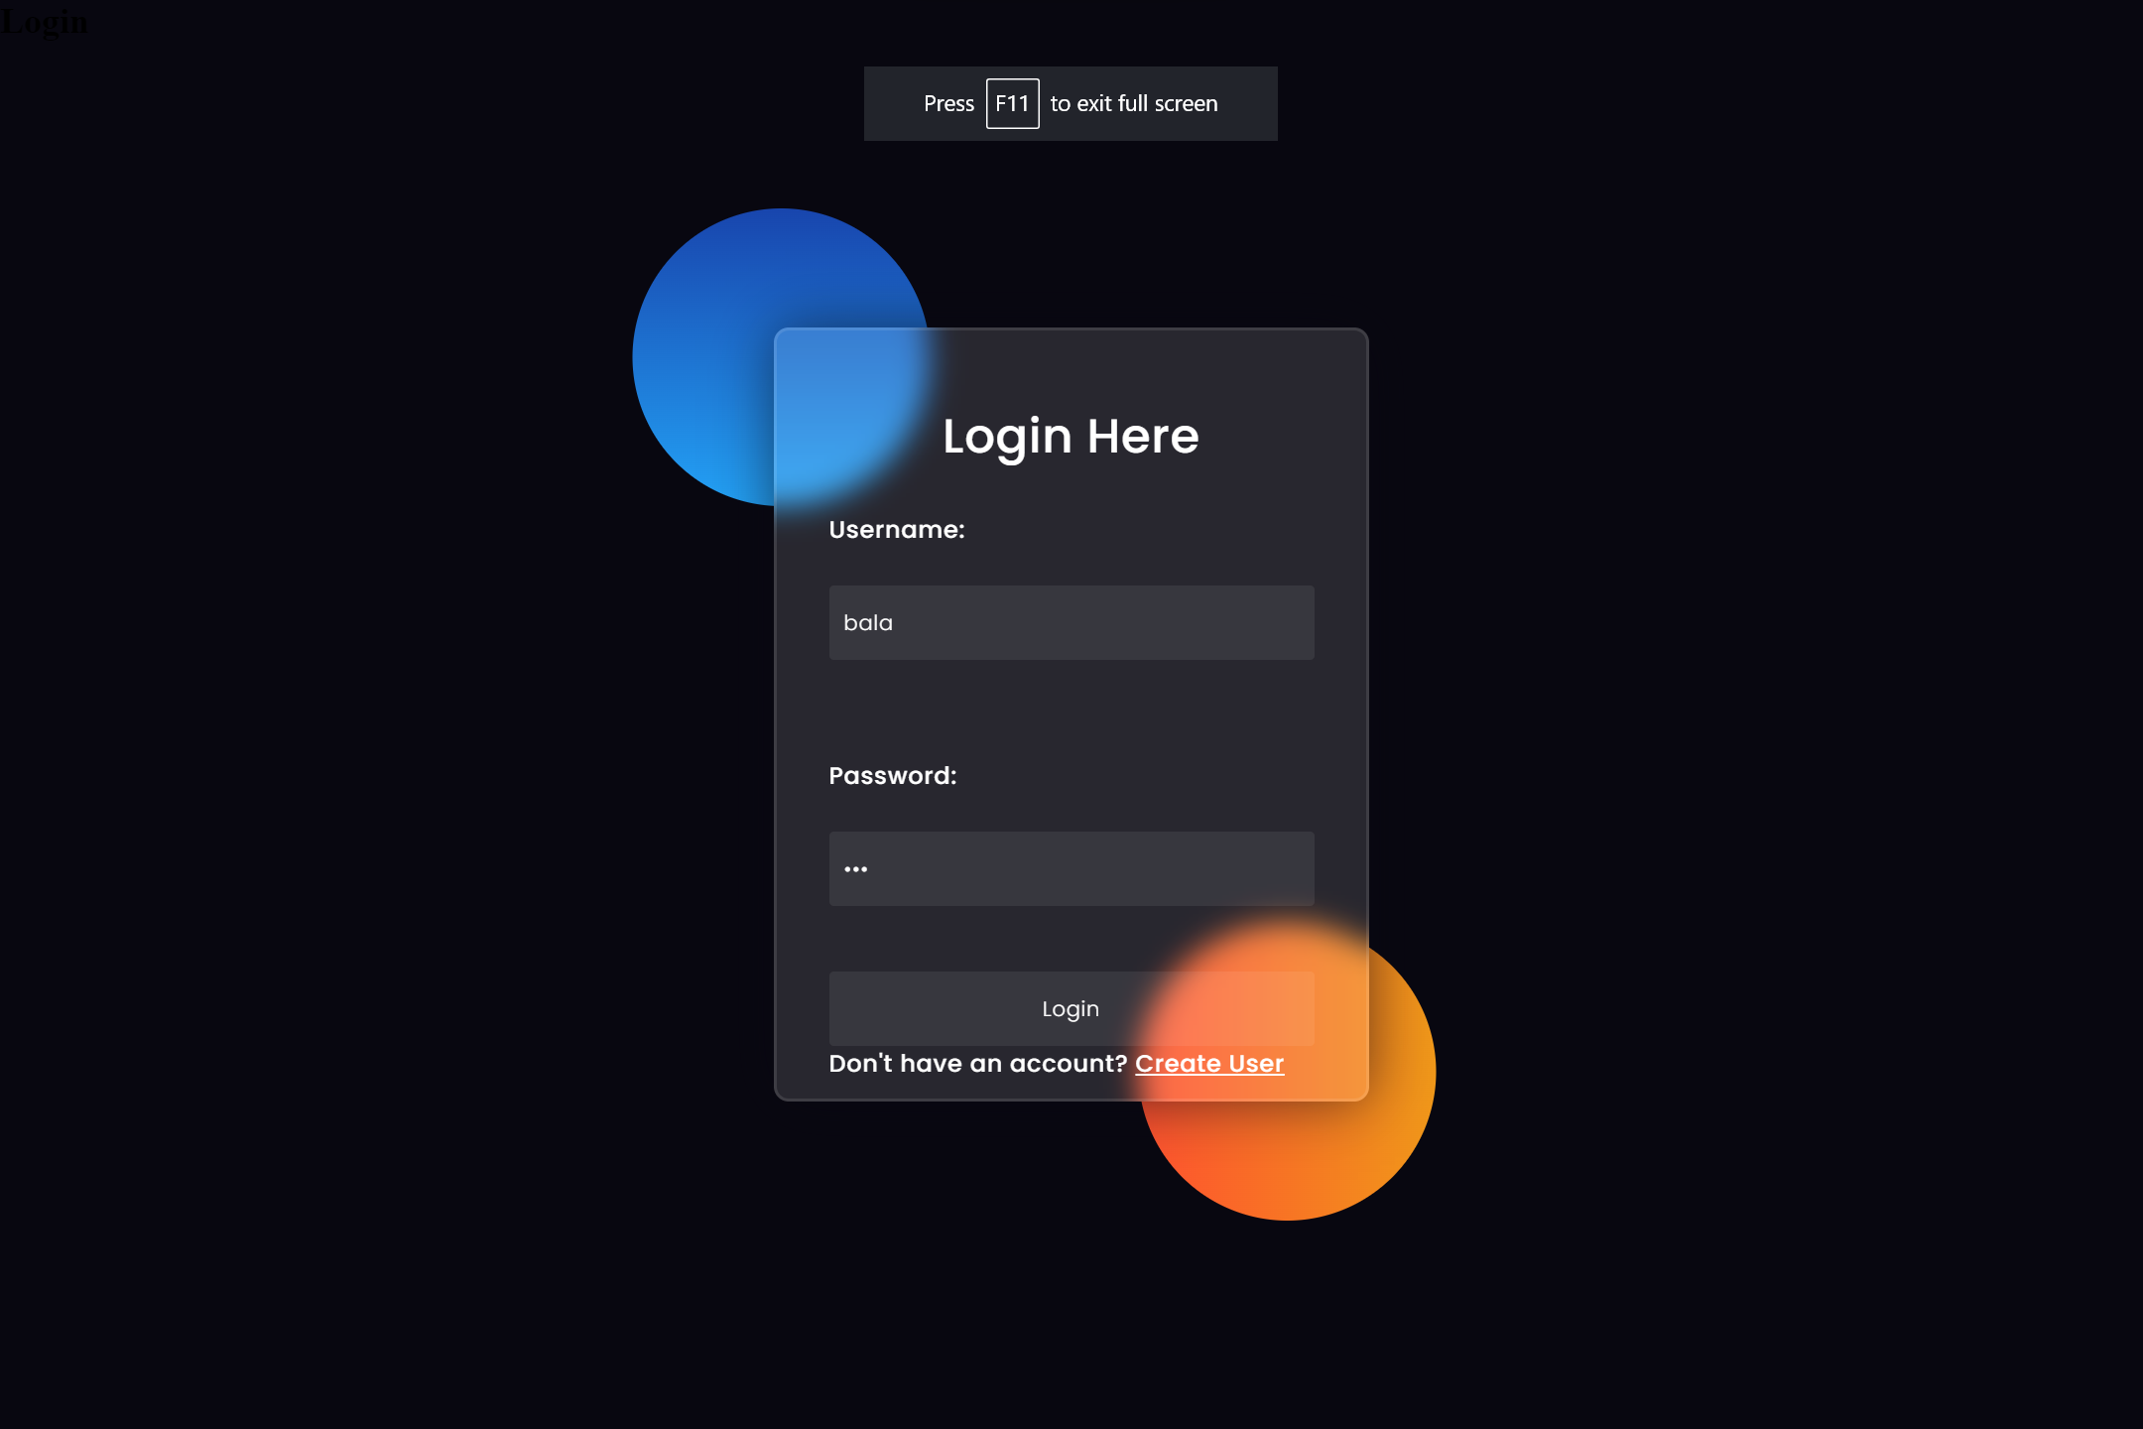

Slide 4
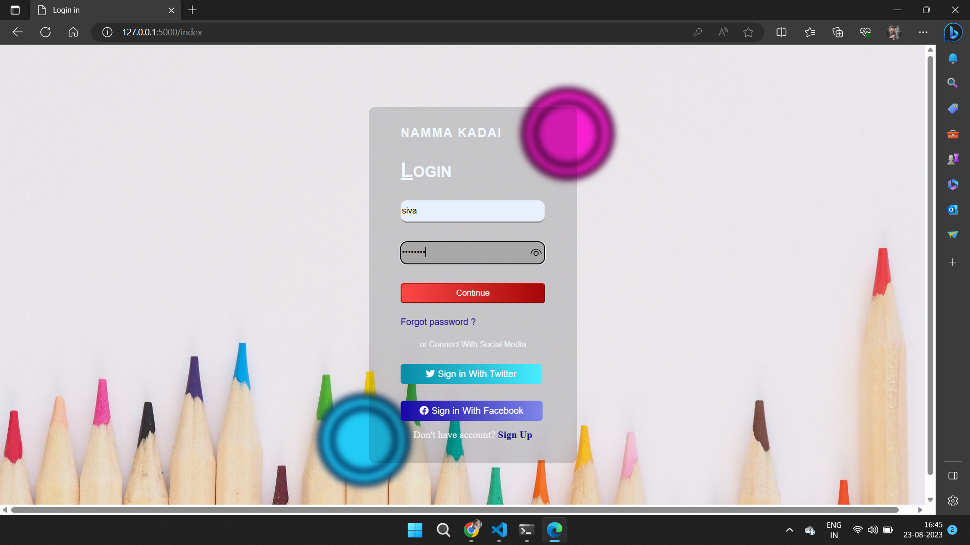
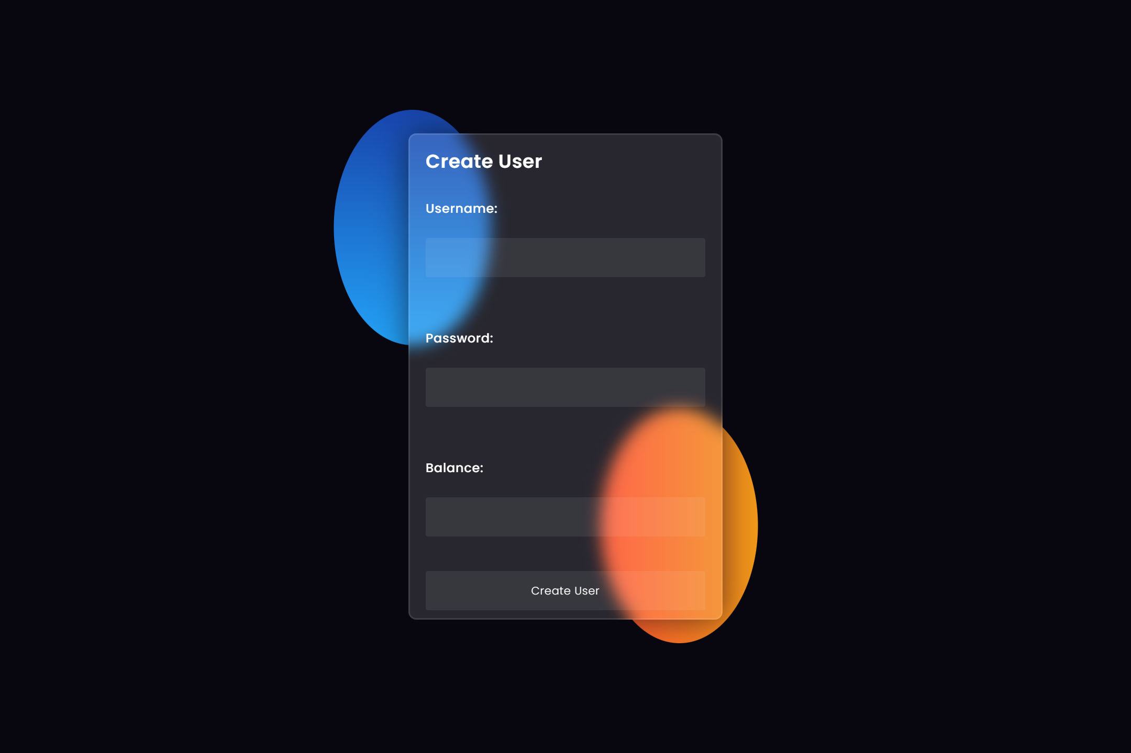

Slide 5
DASHBOARD

Slide 6
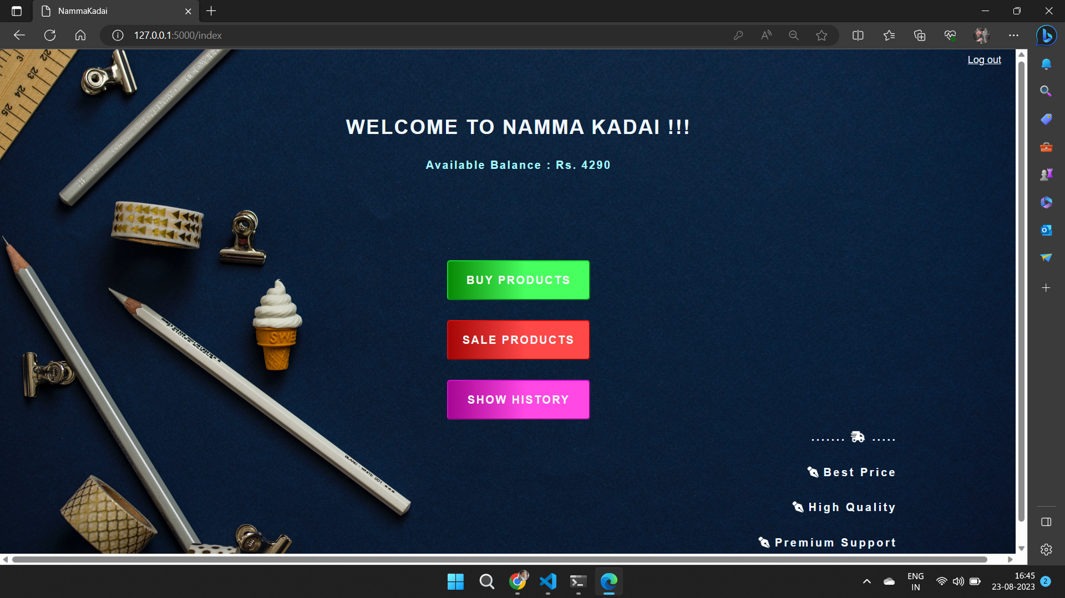


Slide 7
On the dashboard you can perform many actions
Buy Products
Sell Products
Show History

Slide 8
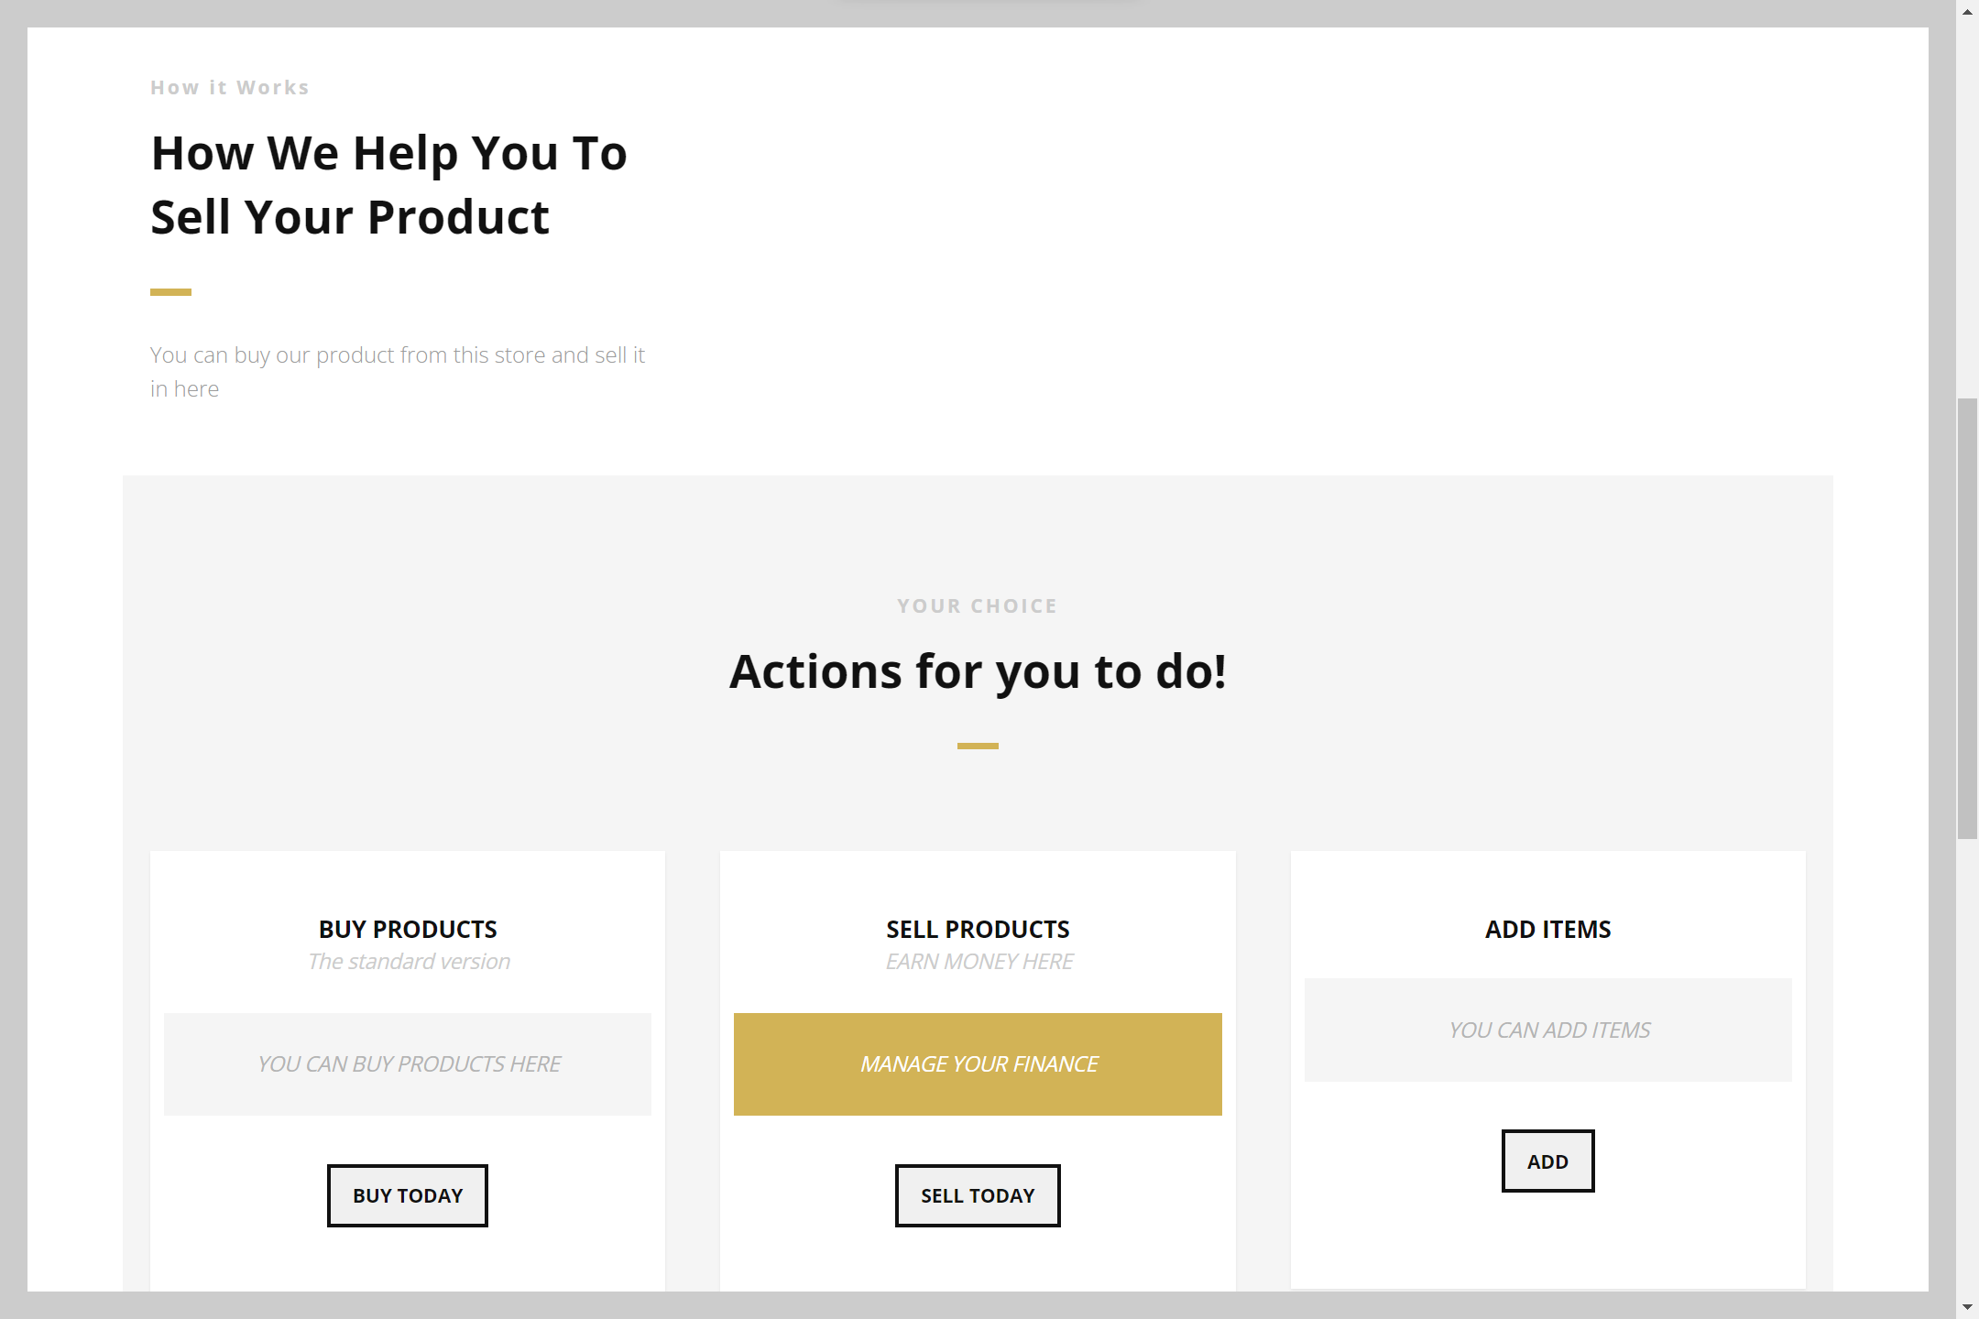
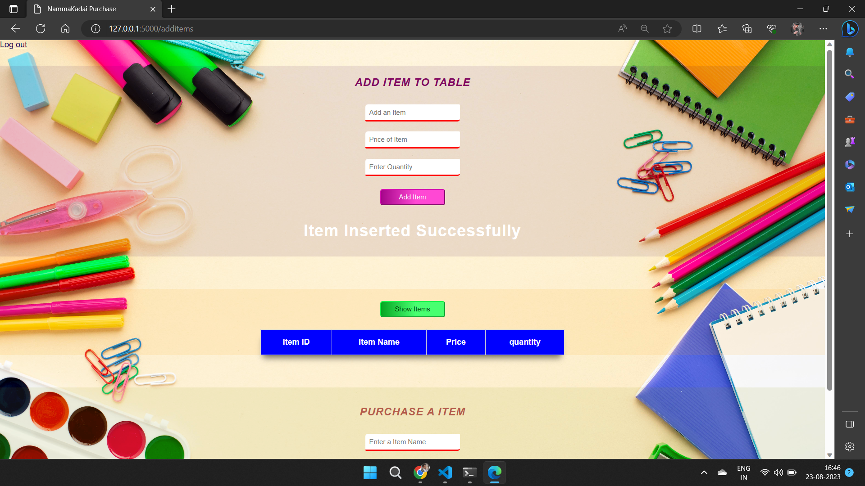

Slide 9
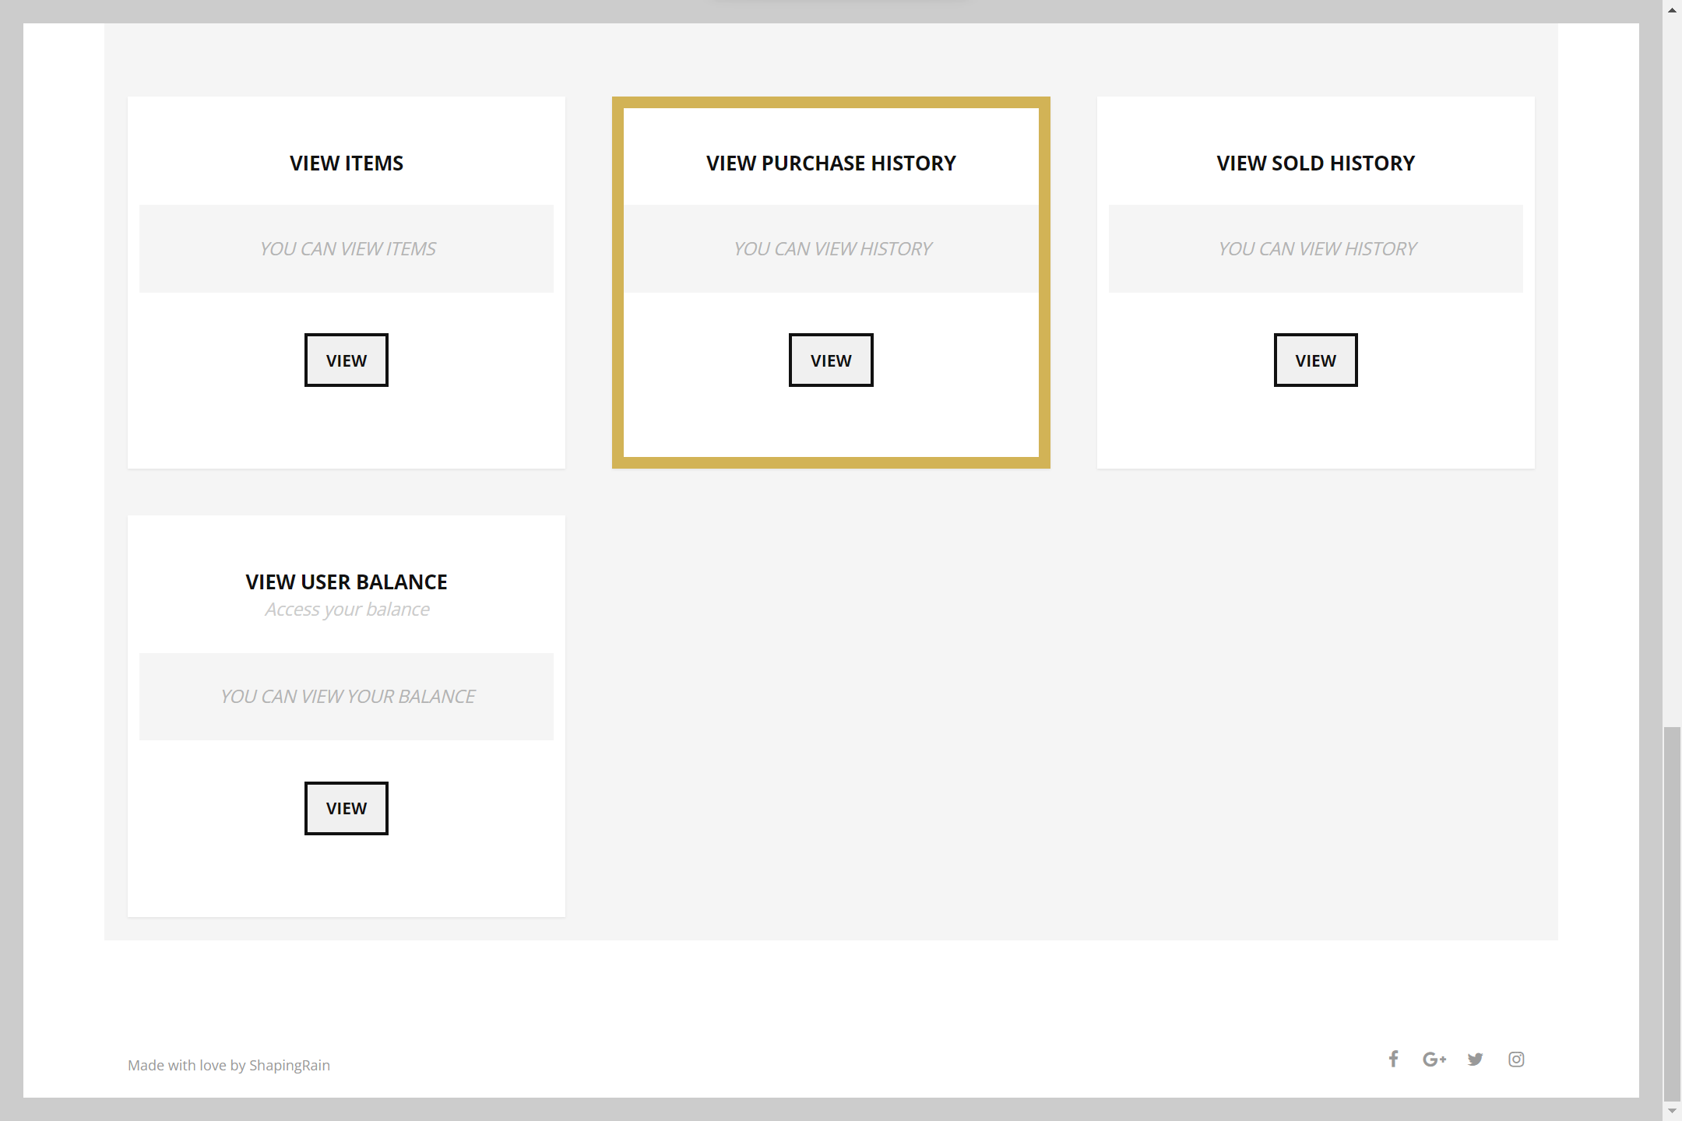
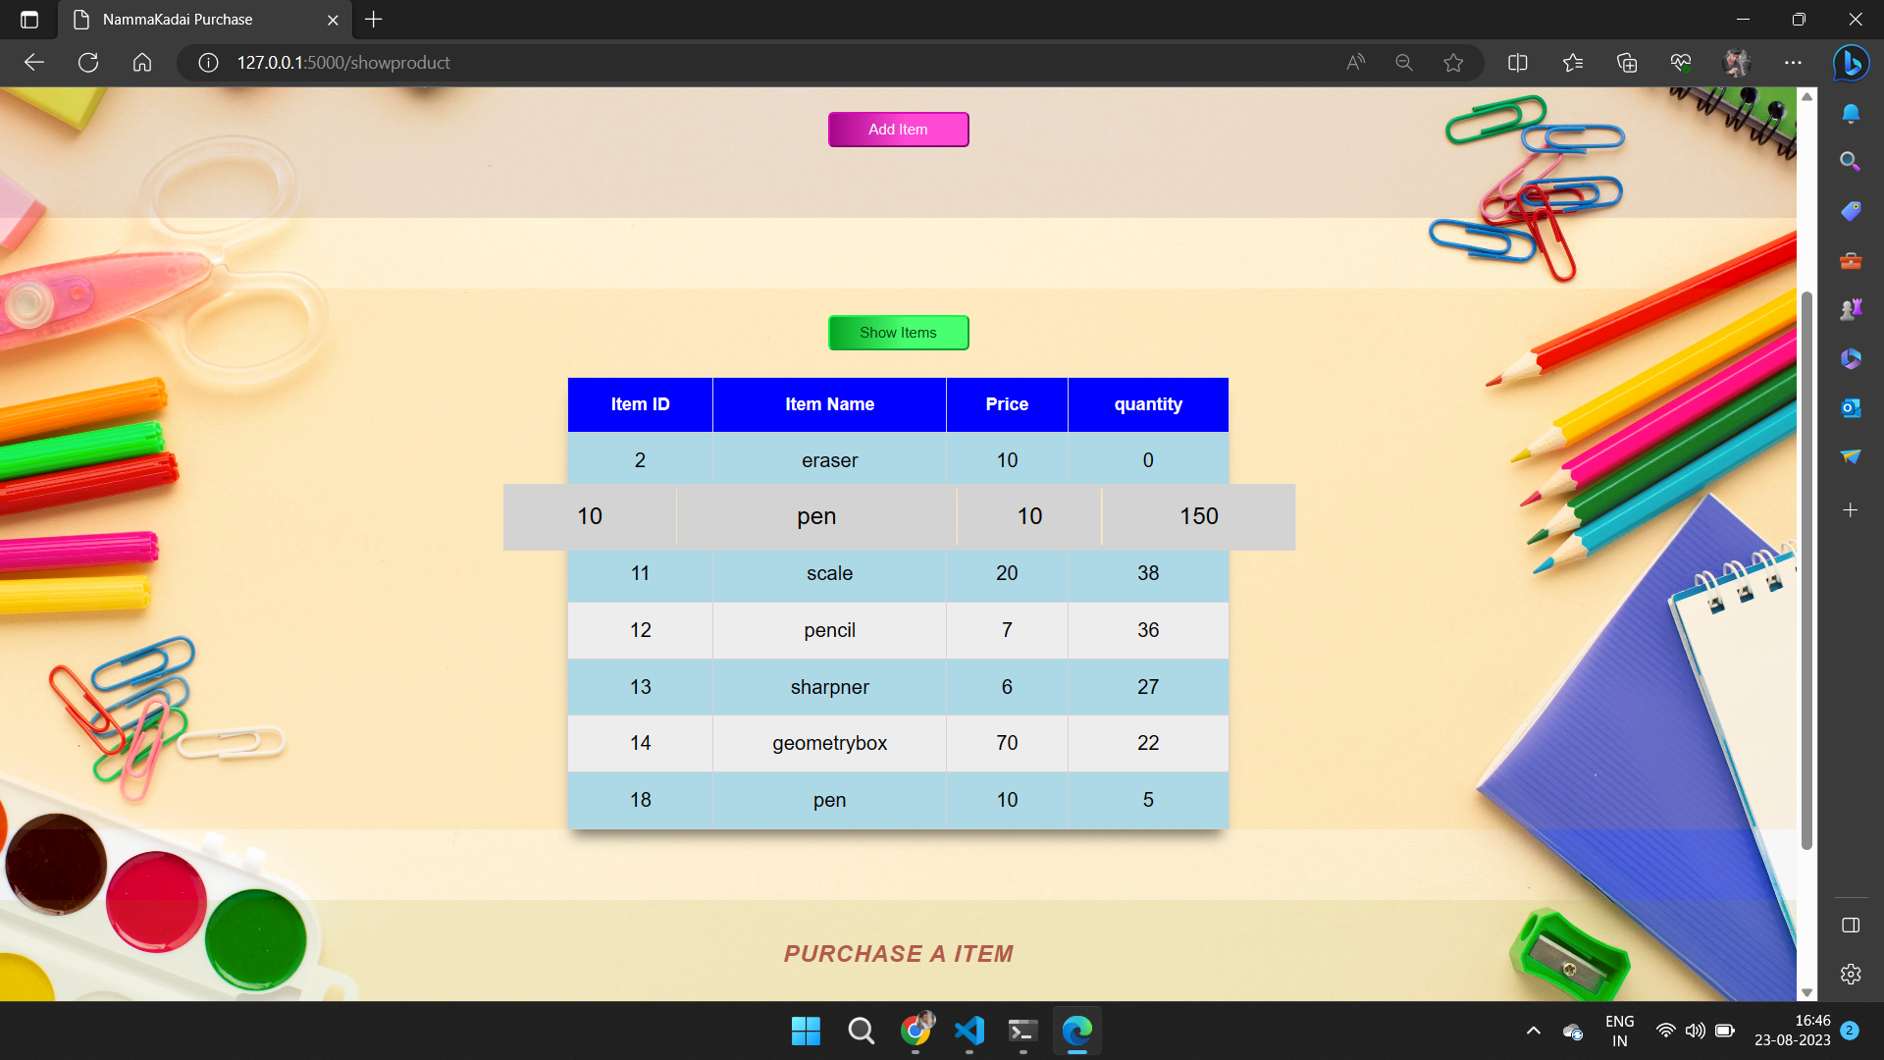

Slide 10
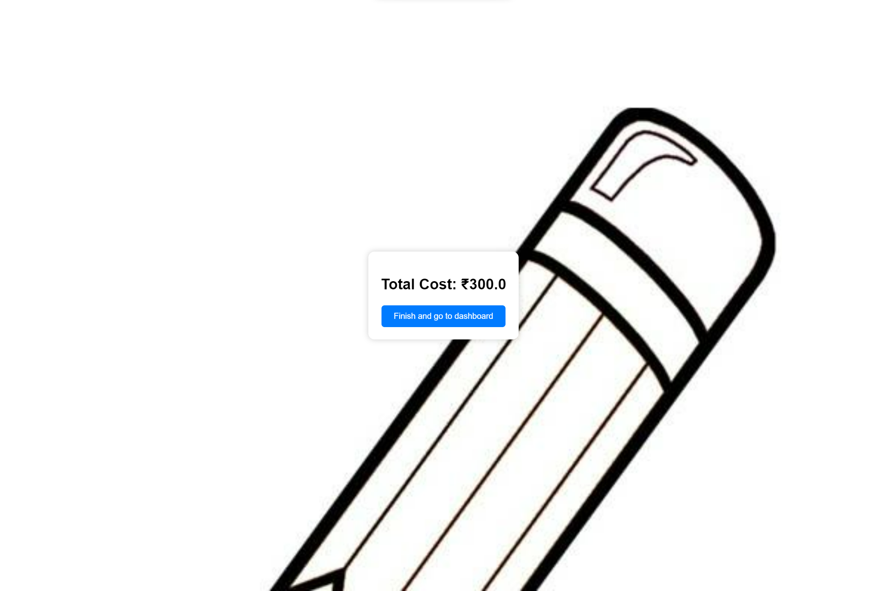
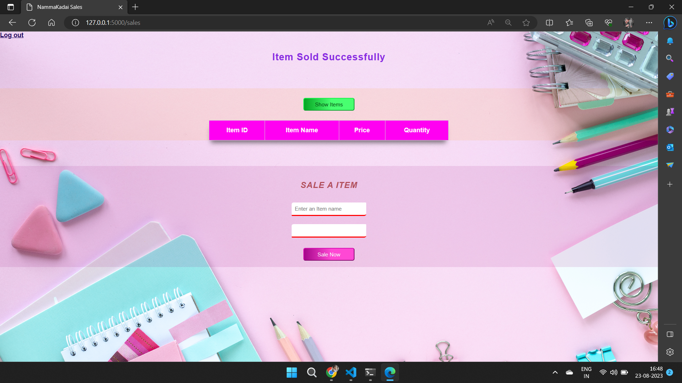

Slide 11
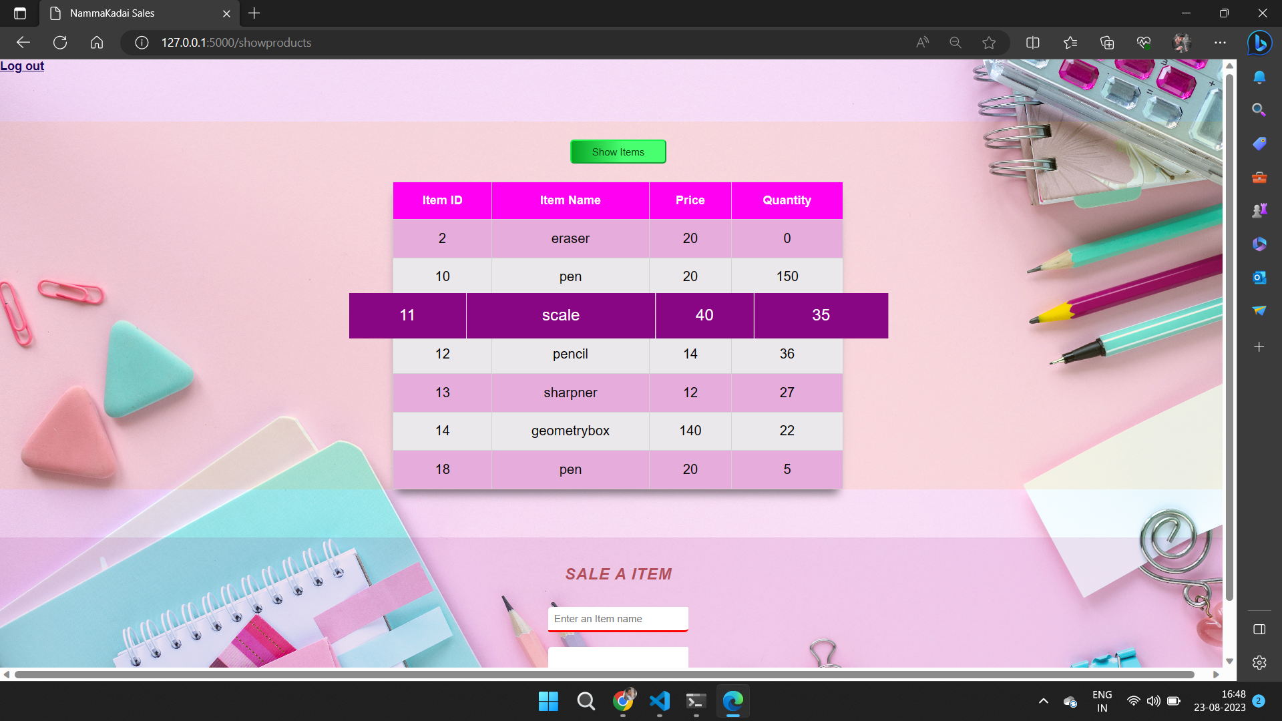
Select sell products
Click calculate
Click go to dashboard

Slide 12
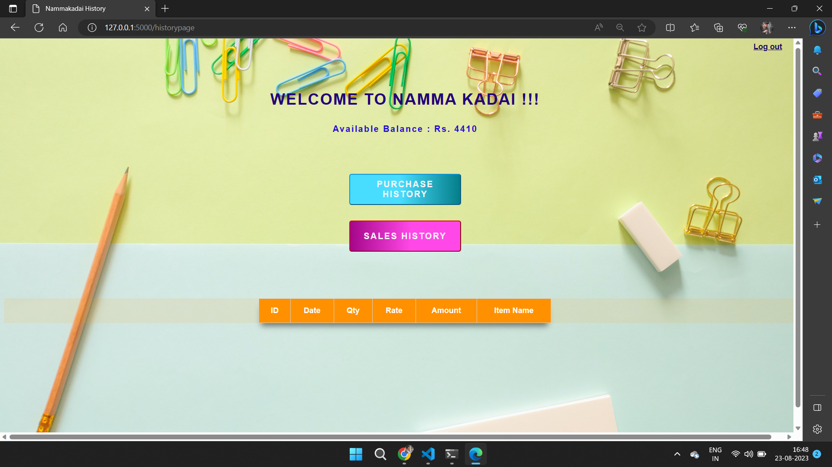

Slide 13

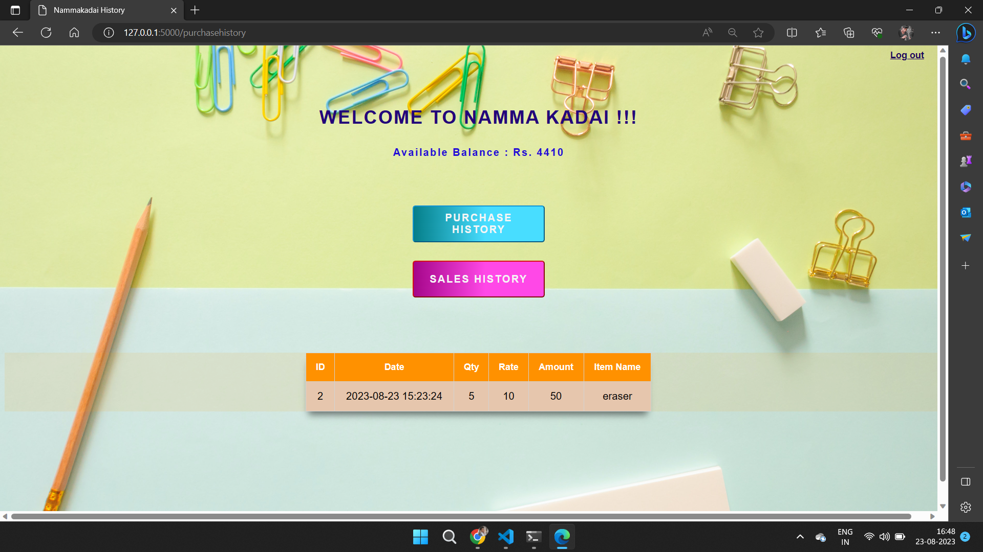

Slide 14

Select buy add items
Enter some item
Click go to dashboard

Slide 15
THANK YOU..

